Slide 1


AHMAD BAIHAQI
20/10/2026

Slide 2

Outline
Executive Summary
Introduction
Methodology
Results
Conclusion
Appendix

Slide 3
Executive Summary
Methodologies Applied:
  Extracted Falcon 9 historical launch data via SpaceX REST API and web scraping (Wikipedia).
  Cleaned and preprocessed data, handling missing payload values and encoding binary landing outcomes (1 = Success, 0 = Failure).
  Conducted Exploratory Data Analysis (EDA) using SQL queries and visual charts (Seaborn/Matplotlib).
  Built interactive geospatial maps with Folium and an analytical dashboard using Plotly Dash.
  Trained and tuned classification models (Logistic Regression, SVM, Decision Tree, KNN) with GridSearchCV.
Key Results & Findings:
  Launch success rates increased significantly over time, reaching >80% with newer booster iterations (Block 5).
  Payloads between 2,000 kg and 5,500 kg and orbits such as SSO, HEO, and GEO showed the highest landing success rates.
  All four tuned classification models achieved ~83.3% test accuracy, with the Decision Tree and SVM models demonstrating strong precision and recall for successful booster recoveries.

Slide 4
Introduction
Project Background & Context:
  SpaceX has significantly disrupted the commercial space industry by reducing launch costs to ~$62 million per launch (compared to ~$165 million from competitors).
  These substantial cost savings are achieved primarily through the successful recovery and reuse of the Falcon 9 first-stage booster.
Core Problems & Objectives:
  Can we accurately predict whether the Falcon 9 first stage will land successfully?
  What key factors (e.g., payload mass, launch site, orbit type, flight number) influence landing success?
  How can these predictive insights enable competing launch providers to estimate launch costs and bid competitively against SpaceX?

Slide 5

Section 1

Slide 6
Methodology
Executive Summary
Data collection methodology:
Extracted launch records from SpaceX REST API and scraped historical mission data from Wikipedia using BeautifulSoup.
Perform data wrangling
Handled missing payload values (mean imputation) and created binary landing outcome target variable Class (1 for success, 0 for failure).
Perform exploratory data analysis (EDA) using visualization and SQL
Visualized feature correlations using Matplotlib/Seaborn and executed SQL queries to analyze payload distributions and site performance.

Slide 7
Methodology
Perform interactive visual analytics using Folium and Plotly Dash
Plotted geographical launch clusters and proximity distances using Folium; built interactive dashboard filters using Plotly Dash.
Perform predictive analysis using classification models
Built, optimized, and evaluated Logistic Regression, SVM, Decision Tree, and KNN models using GridSearchCV.

Slide 8
Data Collection
SpaceX REST API Integration:
  Issued GET requests to SpaceX endpoints (/v4/launches/past and static backup endpoint) to extract raw JSON launch records.
  Extracted core booster landing outcomes, payload masses, launchpad geographic coordinates, and booster flight counts.
  Filtered data specifically for Falcon 9 launches (removing Falcon 1) up to November 13, 2020.
Web Scraping (Wikipedia):
  Extracted historical Falcon 9 launch records directly from Wikipedia using Python requests and BeautifulSoup.
  Parsed HTML tables (wikitable) to harvest flight numbers, launch dates, booster types, payloads, and landing sites.
  Converted scraped records into structured tabular format to complement the API records.

Slide 9
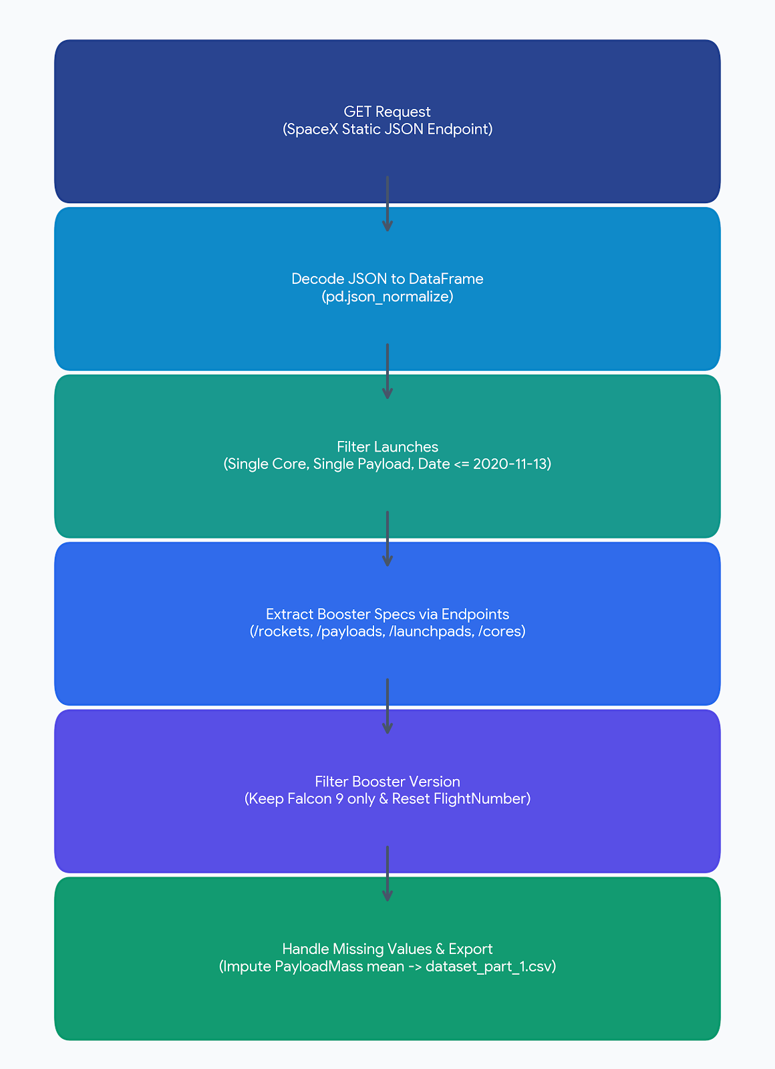
Data Collection – SpaceX API
Request: GET request to static endpoint (API_call_spacex_api.json) and parsed with pd.json_normalize()
Filtering: Isolated single-core and single-payload missions up to 2020-11-13
Feature Extraction: Mapped booster, payload, launchpad, and core details
Wrangling: Filtered for Falcon 9, imputed missing PayloadMass using mean, and exported to dataset_part_1.csv
GitHub URL: https://github.com/shadowdragon-arch/API-Lab.git

Slide 10
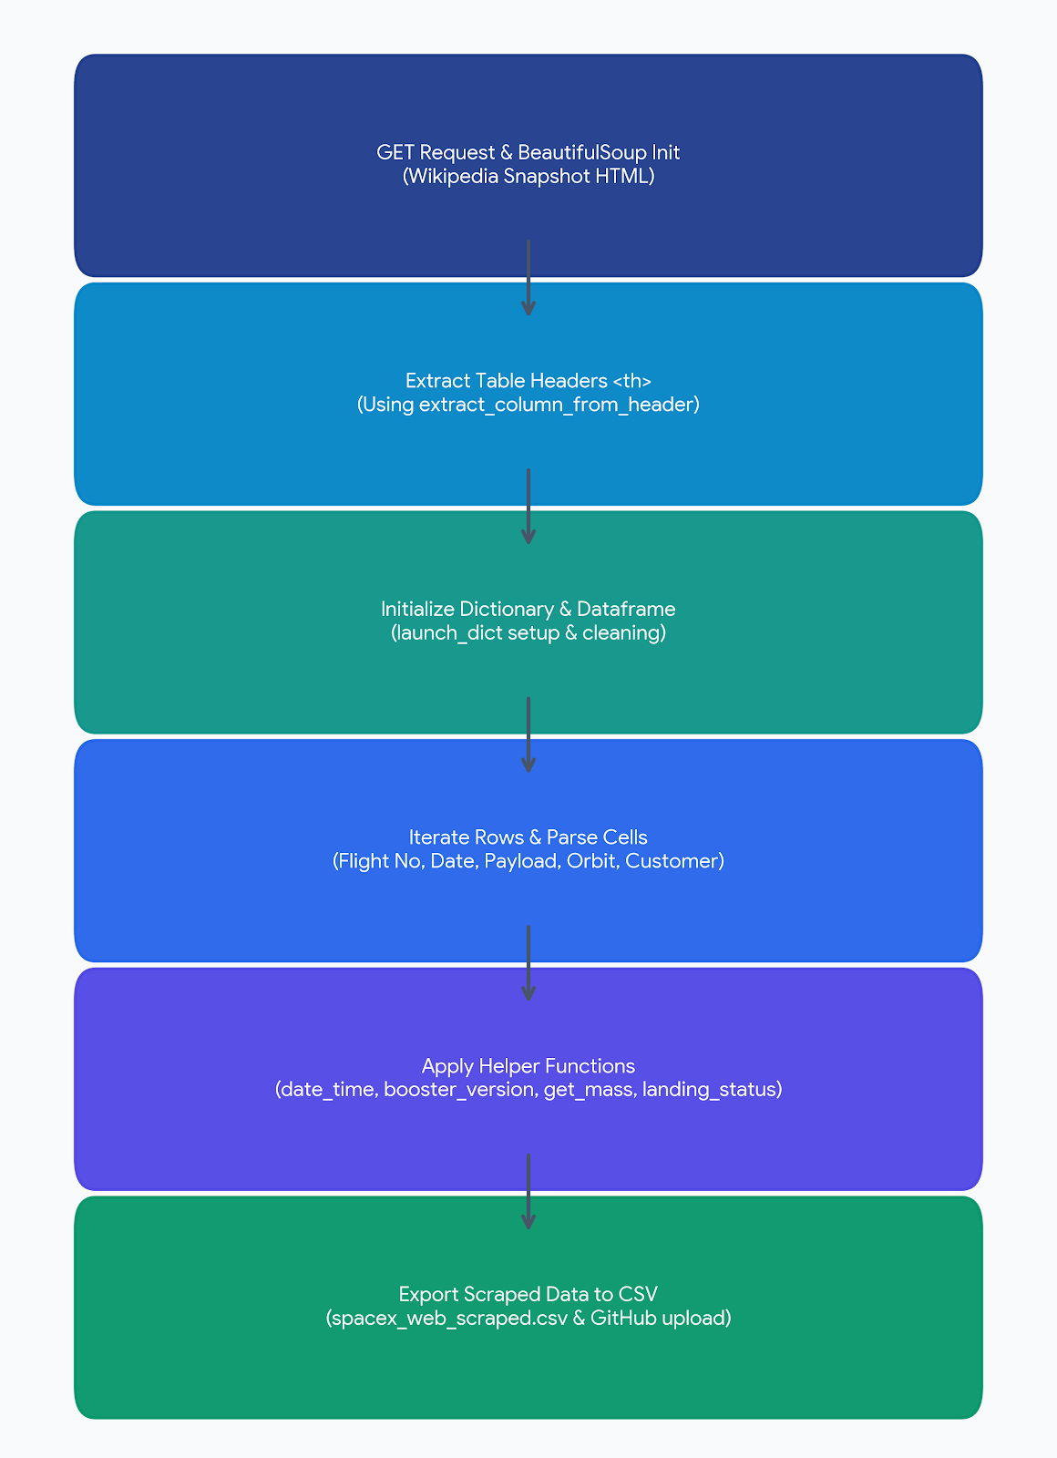
Data Collection - Scraping
Request & Parse: Performed GET request on the Wikipedia historical launch snapshot (oldid=1027686922) and initialized a BeautifulSoup object.
Header Extraction: Extracted table columns (<th>) using custom helper function extract_column_from_header().
Data Extraction: Iterated through launch table rows (<tr> and <td>), cleaning cell noise and parsing mission attributes (Flight No., Date, Version Booster, Launch Site, Payload, Orbit, Customer, Outcome, Booster Landing).
DataFrame Conversion & Export: Compiled data into launch_dict, structured into a Pandas DataFrame, and exported as spacex_web_scraped.csv.
GITHUB URL: https://github.com/shadowdragon-arch/API-Lab.git

Slide 11
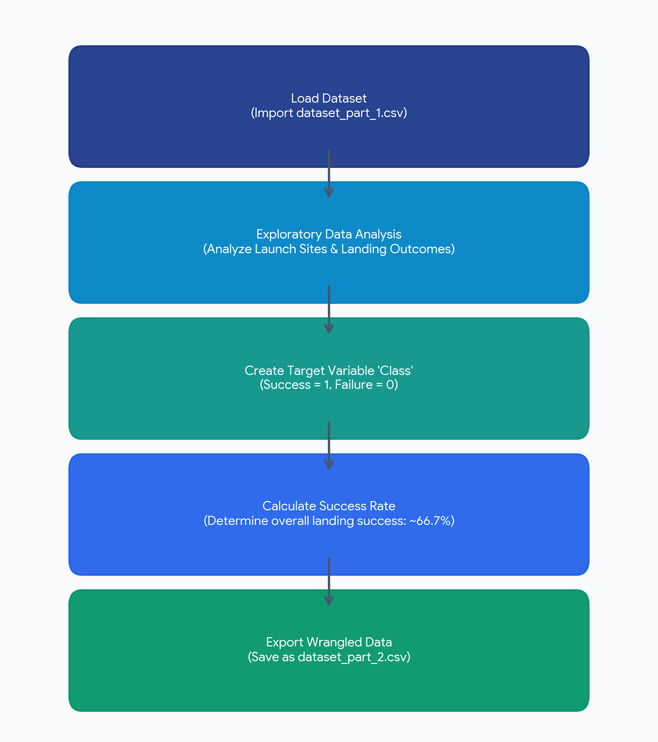
Data Wrangling
Data Processing Steps:
Loaded the initial cleaned API data (dataset_part_1.csv).
Performed EDA to calculate launch occurrences per site and landing outcomes.
Created a binary target variable, Class, where 1 represents a successful landing and 0 represents a failure.
Determined the baseline landing success rate (66.7%).
Exported the finalized feature set as dataset_part_2.csv.
GITHUB URL: https://github.com/shadowdragon-arch/API-Lab.git

Slide 12
EDA with Data Visualization
Summary of Charts Plotted & Their Purpose:
Scatter Plots (Flight Number vs. Launch Site / Payload Mass): Used to identify correlations between experience (flight number), payload mass, and the choice of launch site, highlighting how these factors relate to landing success (Class).
Bar Chart (Success Rate by Orbit Type): Used to compare the average landing success rate across different target orbits (e.g., LEO, GTO, SSO), revealing which orbits are easiest or hardest to land from.
Line Chart (Success Rate over Years): Used to visualize the trend of SpaceX's landing success over time, demonstrating how success rates improved significantly as the company gained operational experience from 2013 onwards.
GitHub URL: https://github.com/shadowdragon-arch/API-Lab.git

Slide 13
EDA with SQL
Summary of SQL Queries Performed:
Identified Launch Sites: Queried the dataset to find all unique launch sites to understand facility distribution.
Filtered Specific Missions: Selected records for specific customers (e.g., NASA) and payload mass ranges to analyze mission profiles.
Aggregated Payload Data: Calculated the total and average payload mass carried by specific booster versions (e.g., F9 v1.1).
Extracted Key Milestones: Used the MIN(Date) function combined with filtering to find the exact date of the first successful landing on a ground pad.
Grouped & Ranked Outcomes: Counted the frequency of various landing outcomes and grouped them by launch site and booster version to evaluate success patterns over time.
GitHub URL: https://github.com/shadowdragon-arch/API-Lab.git

Slide 14
Build an Interactive Map with Folium
Summary of Map Objects Created:
Markers & MarkerClusters: Added folium.Marker to pinpoint launch sites and nearby points of interest (cities, highways, coastlines). Used MarkerCluster to group historical success/failure records at each site cleanly.
Circles: Added folium.Circle to visually highlight the launch pad areas and color-code successful vs. failed landing attempts.
PolyLines: Added folium.PolyLine to draw visible distance lines between the launch sites and their closest geographic features.
Why These Objects Were Added:
These objects were added to perform a spatial analysis. By visualizing the map, we can clearly see the geographic patterns and logistical decisions behind SpaceX's site selection (e.g., measuring exact distances to infrastructure and safe zones).
GitHub URL: https://github.com/shadowdragon-arch/API-Lab.git

Slide 15
Build a Dashboard with Plotly Dash
Summary of Plots, Graphs, and Interactions Added:
Interactions: Added a Dropdown menu to select specific launch sites (or 'All Sites') and a Range Slider to select specific payload mass ranges (0 to 10,000 kg).
Plots/Graphs: Added an interactive Pie Chart and a Scatter Plot that dynamically update based on the user's input from the dropdown and slider.
Why These Plots and Interactions Were Added:
Dropdown & Pie Chart: The dropdown allows users to drill down into specific locations. The pie chart was added to quickly visualize the overall contribution of each site to total successful launches, or to see the exact success-to-failure ratio for an individual site.
Range Slider & Scatter Plot: The slider lets users test different weight constraints. The scatter plot (colored by Booster Version) was added to uncover correlations—specifically, whether heavier or lighter payloads affect the success rate, and which booster versions handle those payloads best.
GitHub URL: https://github.com/shadowdragon-arch/API-Lab.git

Slide 16
Predictive Analysis (Classification)
Exploratory Data Analysis (EDA): Include the scatter plots or bar charts generated during your analysis (such as Flight Number vs. Launch Site or Payload Mass vs. Orbit/Class) and the Folium map screenshot showing launch site locations.
Interactive Analytics Demo: Include screenshots of your Plotly Dash interactive dashboard, highlighting the dropdown filters for launch sites and payload range sliders.

Slide 17
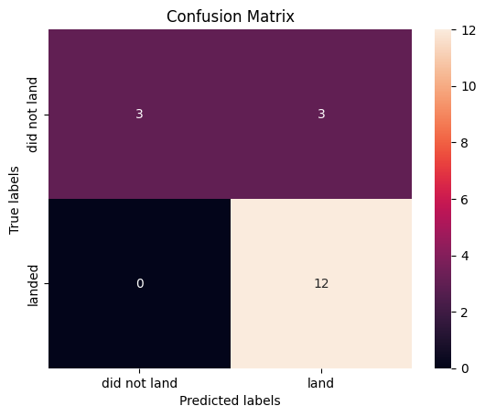
Results
All models achieved approximately 83.33% accuracy on the test set, with each sharing similar confusion matrix behavior (identifying successful landings accurately, with a few false positives on failed landings due to small sample size).
GitHub URL: https://github.com/shadowdragon-arch/API-Lab.git

Slide 18

Section 2

Slide 19
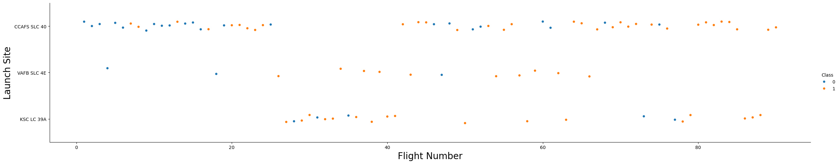
Flight Number vs. Launch Site
Key Findings & Explanation:
CCAFS SLC 40 was the primary launch site used during early missions (Flight Numbers 1 to ~25), showing a higher rate of landing failures (Class 0).
As flight numbers progressed, launches diversified to VAFB SLC 4E and KSC LC 39A, coinciding with significant improvements in landing recovery success rates (Class 1).
Higher flight numbers strongly correlate with successful first-stage landings across all launch sites due to technological maturity and booster design upgrades (Block 5).

Slide 20
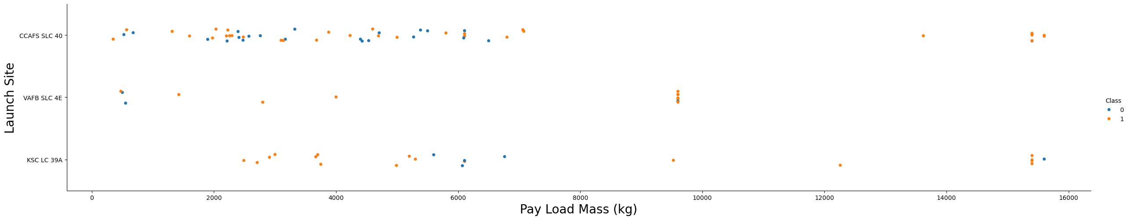
Payload vs. Launch Site
Key Findings & Explanation:
Heavy payload missions (>8,000 kg, especially Starlink constellation launches ~15,600 kg) are predominantly handled by CCAFS SLC 40 and KSC LC 39A, both demonstrating high landing success rates even under maximum payload weights.
VAFB SLC 4E handles polar orbit missions with payloads mostly concentrated under 5,000 kg or around 9,600 kg (Iridium missions), with very consistent recovery performance.
There are no heavy payloads (>10,000 kg) launched from VAFB SLC 4E.

Slide 21
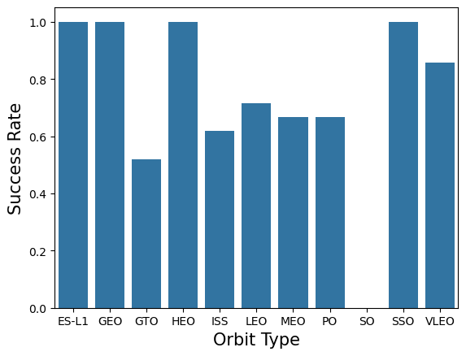
Success Rate vs. Orbit Type
Key Findings & Explanation:
High-altitude and specialized orbits including ES-L1, GEO, HEO, and SSO achieved a 100% success rate for first-stage booster landings.
Lower Earth orbit missions like VLEO (~85%), LEO (~71%), and ISS (~62%) maintain high success rates, benefiting from shorter booster return trajectories.
GTO (Geostationary Transfer Orbit) exhibits a moderate success rate (~52%) because the high velocity and extreme thermal re-entry reduce the fuel margin available for landing maneuvers.
SO (Sun-synchronous test orbit) recorded a 0% success rate due to mission failure during the early testing phase.

Slide 22
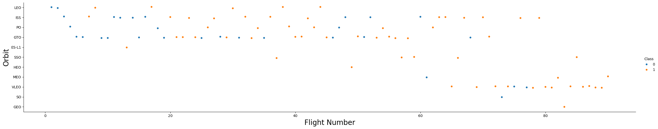
Flight Number vs. Orbit Type
Key Findings & Explanation:
Early flight missions (Flights 1 to 30) were concentrated on LEO, ISS, and GTO orbits with varying landing success.
Later flight numbers (Flights >60) shifted heavily towards VLEO (Very Low Earth Orbit for Starlink satellites), where landing outcomes show near-perfect success rates (Class 1).
Over time, booster reusability expanded across multiple orbital profiles without compromising mission success.

Slide 23
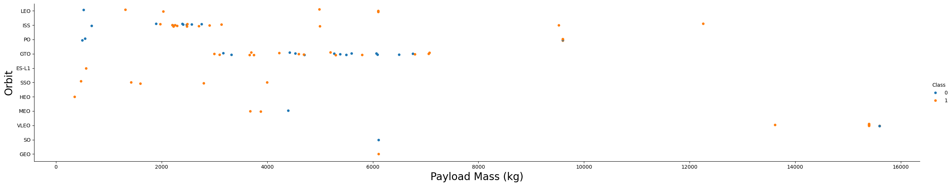
Payload vs. Orbit Type
Key Findings & Explanation:
Heavier payloads (>13,000 kg to ~15,600 kg) are exclusively deployed into VLEO orbits and demonstrate a near-flawless booster landing success rate.
Payloads sent to ISS (2,000 kg – 5,000 kg) and LEO also maintain strong recovery records.
In GTO, payloads range from 3,000 kg to 7,000 kg where both successful and unsuccessful landings coexist, indicating payload mass combined with orbital velocity creates significant recovery constraints.

Slide 24
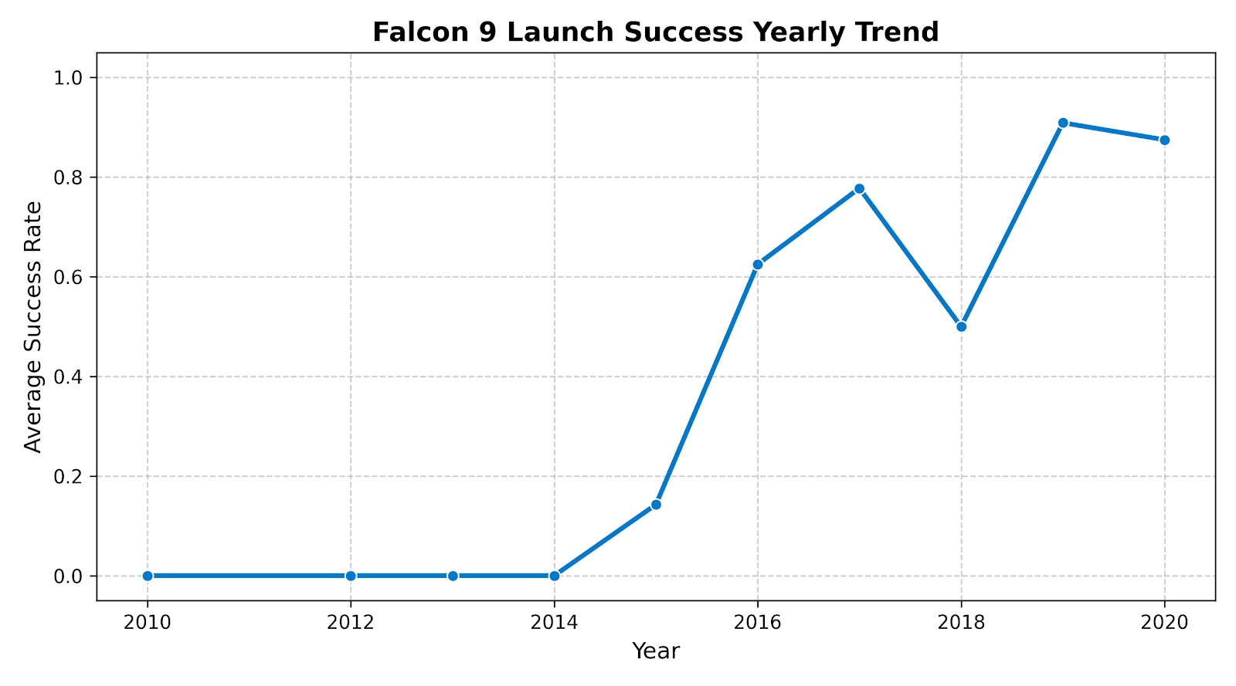
Launch Success Yearly Trend
Key Findings & Explanation:
From 2010 to 2013, the landing success rate remained at 0% as SpaceX was conducting early vehicle tests and uncontrolled ocean landings.
The success rate began rising sharply in 2015 following the first successful landing attempts, reaching ~62% in 2016 and nearly ~80% in 2017.
Despite a minor dip in 2018 during transition testing, the recovery rate achieved over 85–90% by 2019–2020, driven by the mature deployment of flight-proven Block 5 boosters.

Slide 25
All Launch Site Names
SELECT DISTINCT "Launch_Site" FROM SPACEXTABLE;
CCAFS LC-40, VAFB SLC-4E, KSC LC-39A, CCAFS SLC-40
Identifies the four unique SpaceX launch complexes used for Falcon 9 missions, located at Cape Canaveral (Florida) and Vandenberg Space Force Base (California).

Slide 26
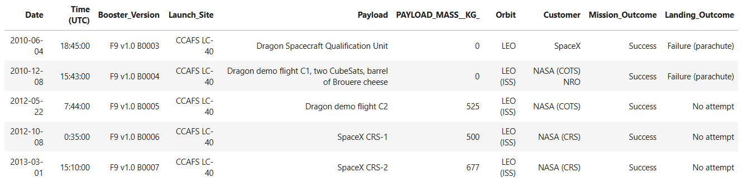
Launch Site Names Begin with 'CCA'
SELECT * FROM SPACEXTABLE
WHERE "Launch_Site" LIKE 'CCA%'
LIMIT 5;
Retrieves the first 5 historical launch records originating from Cape Canaveral Air Force Station (CCAFS LC-40), representing SpaceX's earliest orbital flights from Florida.

Slide 27
Total Payload Mass
%%sql
SELECT SUM(PAYLOAD_MASS__KG_) AS Total_Payload_Mass
FROM SPACEXTABLE
WHERE Customer LIKE '%NASA (CRS)%';
Total_Payload_Mass
48213
Calculates the total cargo mass delivered by Falcon 9 boosters under NASA's Commercial Resupply Services (CRS) contract missions to the International Space Station.

Slide 28
Average Payload Mass by F9 v1.1
SELECT AVG(Payload_Mass__kg_) AS Average_Payload_Mass
FROM SPACEXTABLE
WHERE Booster_Version LIKE '%F9 v1.1%';
Average_Payload_Mass
2534.6666666666665
Determines the baseline mean payload mass lifted by early-generation Falcon 9 v1.1 rocket variants.

Slide 29
First Successful Ground Landing Date
SELECT MIN(Date) AS First_Successful_Ground_Pad_Landing
FROM SPACEXTABLE
WHERE Landing_Outcome = 'Success (ground pad)';
First_Successful_Ground_Pad_Landing
2015-12-22
The historic milestone date when SpaceX accomplished its first-ever successful vertical touchdown of an orbital-class first-stage booster on a ground landing pad (Landing Zone 1).

Slide 30
Successful Drone Ship Landing with Payload between 4000 and 6000
SELECT Booster_Version
FROM SPACEXTABLE
WHERE Landing_Outcome = 'Success (drone ship)'
AND Payload_Mass__kg_ > 4000
AND Payload_Mass__kg_ < 6000;
Booster_Version
F9 FT B1022
F9 FT B1026
F9 FT B1021.2
F9 FT B1031.2
Identifies the Full Thrust (FT) booster versions capable of recovering autonomously on an Autonomous Spaceport Drone Ship (ASDS) while carrying medium-to-heavy satellite payloads.

Slide 31
Total Number of Successful and Failure Mission Outcomes
SELECT Mission_Outcome, COUNT(*) AS Total_Outcomes
FROM SPACEXTABLE
GROUP BY Mission_Outcome;
Mission_Outcome | Total_Outcomes
Failure (in flight) | 1
Success | 98
Success | 1
Success (payload status unclear) | 1
Shows an overall mission primary objective success rate exceeding 98%, underscoring extreme launch reliability despite experimental booster landing recovery attempts.

Slide 32
Boosters Carried Maximum Payload
Booster_Version
F9 B5 B1048.4
F9 B5 B1049.4
F9 B5 B1051.3
F9 B5 B1056.4
F9 B5 B1048.5
F9 B5 B1051.4
F9 B5 B1049.5
F9 B5 B1060.2
F9 B5 B1058.3
F9 B5 B1051.6
F9 B5 B1060.3
F9 B5 B1049.7
SELECT DISTINCT Booster_Version
FROM SPACEXTABLE
WHERE Payload_Mass__kg_ = (SELECT MAX(Payload_Mass__kg_) FROM SPACEXTABLE);
The maximum payload capacity of 15,600 kg is carried exclusively by reusable Falcon 9 Block 5 boosters launching heavy Starlink satellite batches.

Slide 33
2015 Launch Records
SELECT substr(Date, 6, 2) AS Month, Landing_Outcome, Booster_Version, Launch_Site
FROM SPACEXTABLE
WHERE substr(Date, 0, 5) = '2015'
AND Landing_Outcome = 'Failure (drone ship)';
Month | Landing_Outcome | Booster_Version | Launch_Site
01 | Failure (drone ship) | F9 v1.1 B1012 | CCAFS LC-40
04 | Failure (drone ship) | F9 v1.1 B1015 | CCAFS LC-40
Documents early drone ship recovery tests in January and April 2015 that resulted in crash landings before control algorithms and thrusters were perfected.

Slide 34
Rank Landing Outcomes Between 2010-06-04 and 2017-03-20
SELECT Landing_Outcome, COUNT(*) AS Outcome_Count
FROM SPACEXTABLE
WHERE Date BETWEEN '2010-06-04' AND '2017-03-20'
GROUP BY Landing_Outcome
ORDER BY Outcome_Count DESC;
Landing_Outcome | Outcome_Count
No attempt | 10
Success (drone ship) | 5
Failure (drone ship) | 5
Success (ground pad) | 3
Controlled (ocean) | 3
Uncontrolled (ocean) | 2
Failure (parachute) | 2
Precluded (drone ship) | 1
Ranks the recovery attempts across the first seven years; early flights mostly featured no recovery attempts (No attempt), while drone ship and ground pad landing successes steadily caught up by early 2017.

Slide 35

Section 3

Slide 36
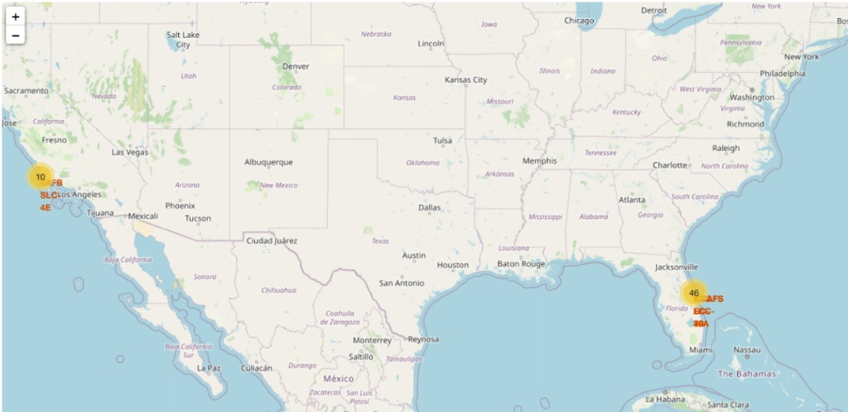
SpaceX Launch Sites Geographical Locations
Proximity to Coastlines: All launch complexes are located directly along ocean coastlines (Vandenberg on the Pacific, Cape Canaveral on the Atlantic) so launch trajectories and stage separations occur safely over water rather than populated landmasses.
Proximity to the Equator: The Florida sites (CCAFS / KSC at ~28.5° N) take advantage of Earth's rotational speed, maximizing orbital launch efficiency for equatorial and geostationary missions.
Polar Trajectory (VAFB): Vandenberg Space Force Base in California enables southward launch trajectories necessary for polar and Sun-synchronous orbits (SSO) without overflying domestic territory.

Slide 37
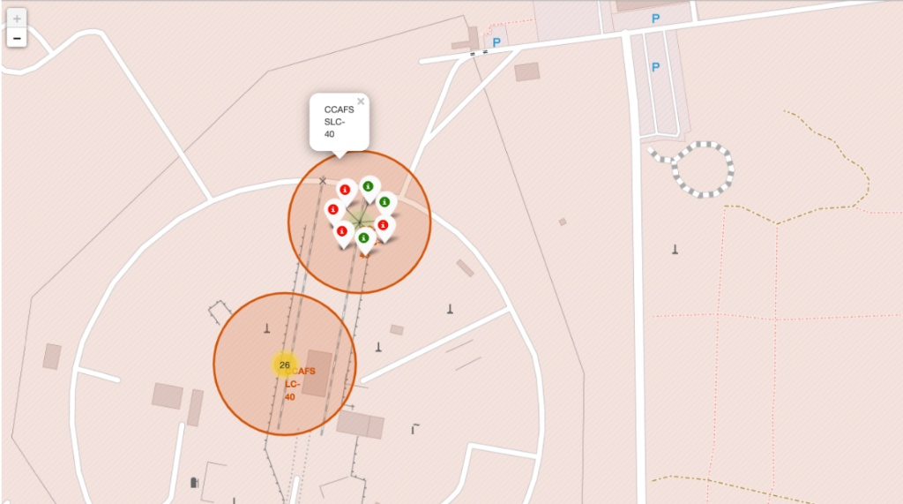
Launch Site Outcome Clustering Analysis
Outcome Markers: Markers are color-coded where green denotes a successful booster landing recovery (Class 1) and red denotes a failed or unrecovered attempt (Class 0).
Site Performance: Launch sites with higher total flight density (CCAFS SLC-40 / LC-40) show an early cluster of failed attempts that transitioned into consistent successes as booster reuse technology matured.
Cluster Optimization: The MarkerCluster feature clusters geographically overlapping launches, making site-specific recovery rates easily distinguishable upon zooming.

Slide 38
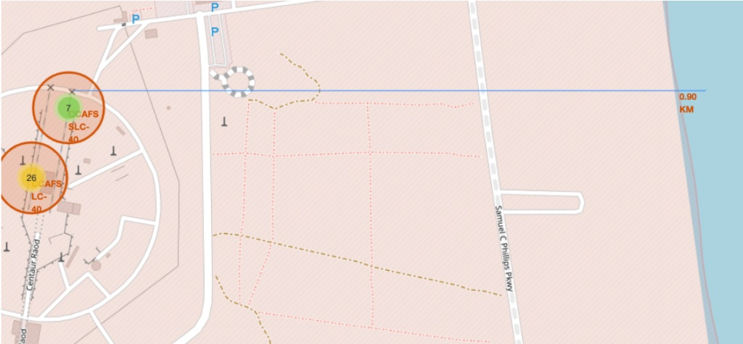
Launch Complex Proximity to Critical Infrastructure and Coastline
Proximity to Coastline: Launch pads are positioned within ~0.90 km of the coastline, allowing rockets to clear land within seconds of liftoff to mitigate hazards.
Proximity to Highways & Railroads: Sites are directly linked to logistics corridors (e.g., Samuel C Phillips Pkwy / railways within 1 km) for transporting massive rocket boosters and payloads.
Safety Distance from Urban Areas: Major civilian population centers are kept at a safe buffer distance (>15–20 km) to safeguard against launch anomalies and acoustic shockwaves.

Slide 39

Section 4

Slide 40
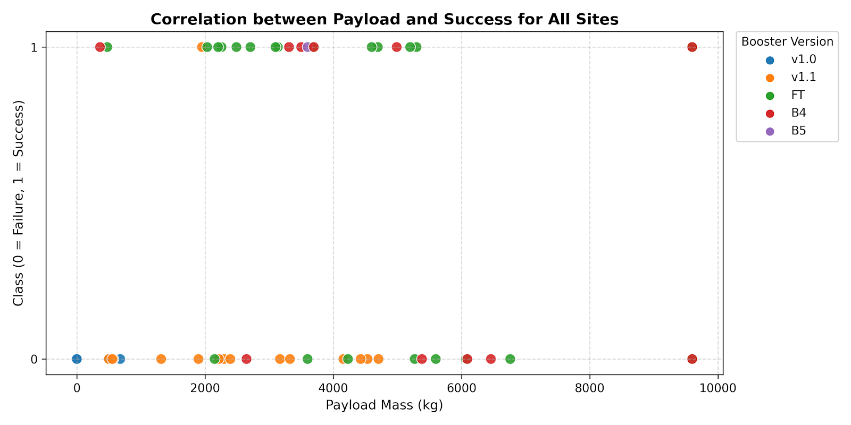
Total Success Launches by Launch Site (All Sites)
Success Contribution: The pie chart illustrates the breakdown of total successful recoveries across all launch complexes:
  KSC LC-39A: 41.7% of all successful landings (10 successes).
  CCAFS LC-40: 29.2% of all successes (7 successes).
  VAFB SLC-4E: 16.7% of all successes (4 successes).
  CCAFS SLC-40: 12.5% of all successes (3 successes).
Primary Finding: KSC LC-39A contributed the highest number of successful booster landings among all SpaceX facilities.

Slide 41
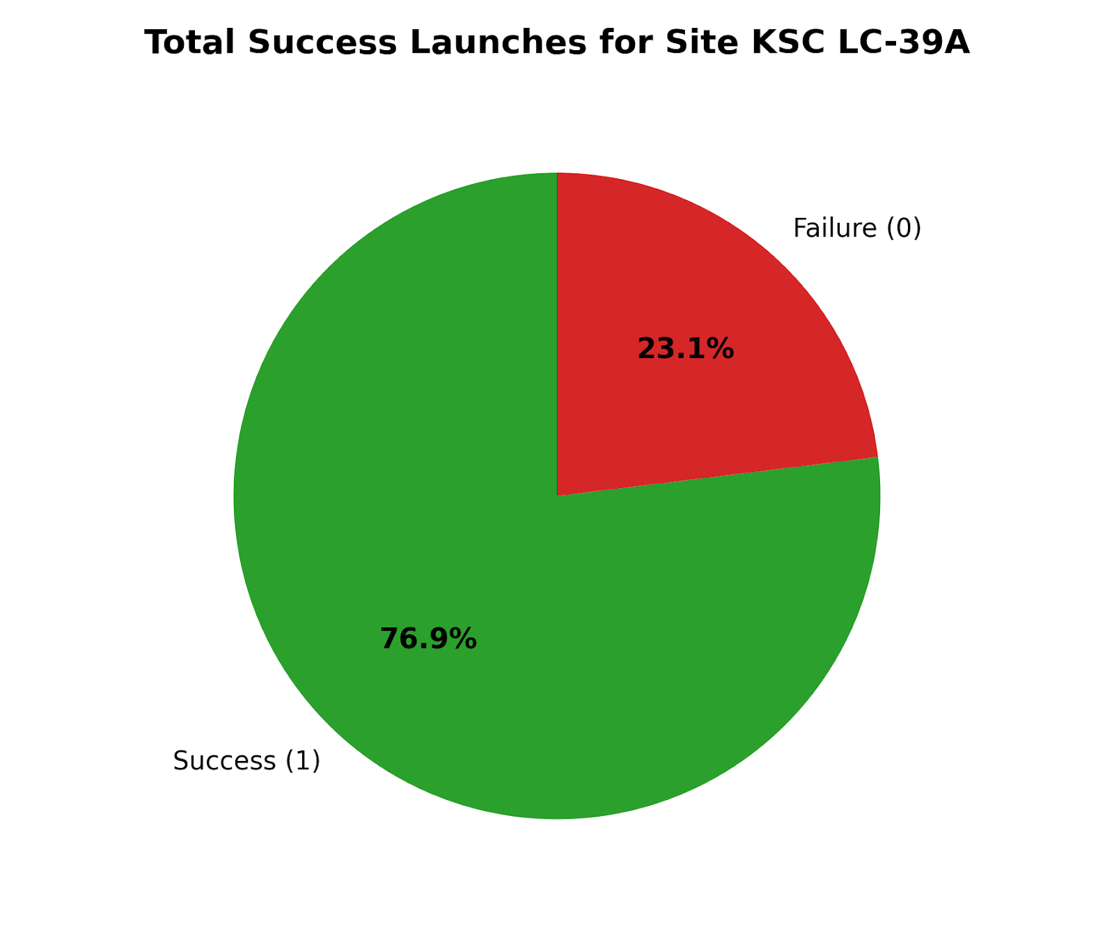
Launch Success Ratio for Site KSC LC-39A
Highest Success Rate: When filtering the dashboard by specific launch sites, KSC LC-39A demonstrates the highest success ratio at 76.9% (10 successful landings out of 13 total missions).
Comparison to Other Sites:
  KSC LC-39A: 76.9% success rate.
  CCAFS SLC-40: 42.9% success rate.
  VAFB SLC-4E: 40.0% success rate.
  CCAFS LC-40: 26.9% success rate.
Key Takeaway: Launch pad KSC LC-39A has the lowest failure rate (23.1%), making it the most reliable site for successful first-stage booster recovery.

Slide 42
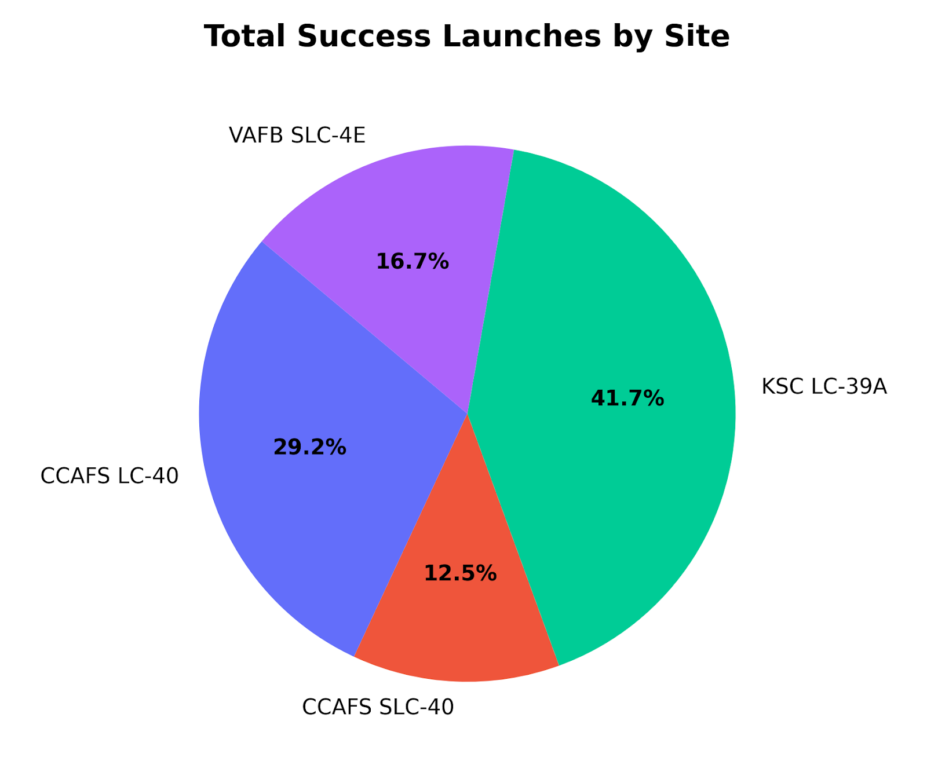
Correlation Between Payload Mass and Launch Success
Optimal Payload Range: Boosters carrying payloads between 2,000 kg and 5,000 kg achieve the most consistent landing recovery success rate (dense concentration of Class = 1 points).
Heavy Payloads (>9,000 kg): Shows a 100% booster recovery success rate for modern flights (such as Starlink deployments at 9,600 kg).
Booster Version Performance:
  Block 5 (B5) and B4: Exhibit superior recovery performance with virtually no booster loss in recent flights.
  Full Thrust (FT): Achieved consistent successes across both moderate and heavy payload ranges.
  v1.0 & v1.1: Account for most failed attempts (Class = 0), which occurred predominantly during earlier test missions with lighter payloads (<3,500 kg).

Slide 43

Section 5

Slide 44
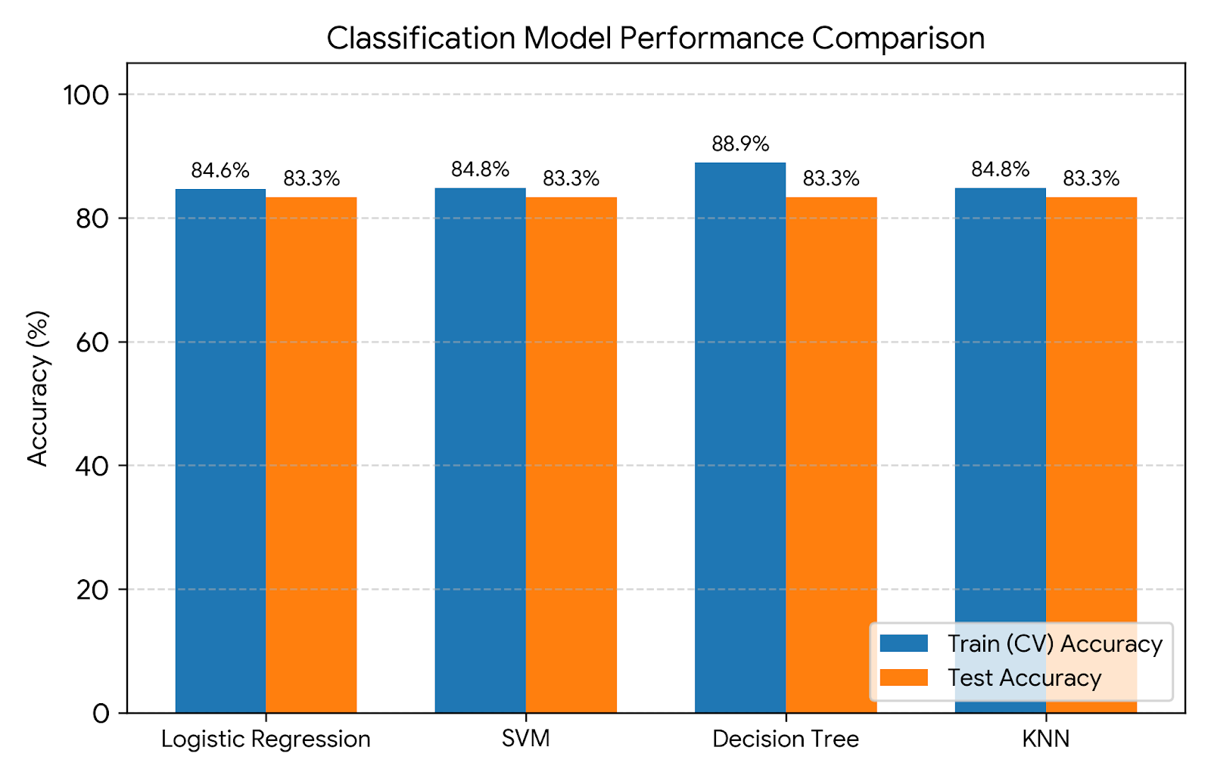
Classification Accuracy
Model Training & Tuning:
  Four classification algorithms were trained using GridSearchCV with 10-fold cross-validation: Logistic Regression, Support Vector Machine (SVM), Decision Tree, and K-Nearest Neighbors (KNN).
Evaluation Results:
  Decision Tree: Best Cross-Validation Score: 88.93% | Test Accuracy: 83.33%.
  SVM (Sigmoid Kernel): Best Cross-Validation Score: 84.82% | Test Accuracy: 83.33%.
  KNN (k=10): Best Cross-Validation Score: 84.82% | Test Accuracy: 83.33%.
  Logistic Regression: Best Cross-Validation Score: 84.64% | Test Accuracy: 83.33%.
Verdict: All models achieved an identical test accuracy of 83.33% on the unseen test set, with Decision Tree yielding the highest validation score during hyperparameter tuning.

Slide 45
Confusion Matrix
Confusion Matrix Breakdown (Test Set = 18 samples):
  True Positives (Landed = 1): 12 cases correctly predicted as successful landings.
  True Negatives (Did not land = 0): 3 cases correctly identified as landing failures.
  False Positives: 3 cases where the booster failed, but the model predicted success.
  False Negatives: 0 cases (recall for successful landings is 100%).
Key Insight: The models excel at correctly identifying successful booster landings, while the minor error margin stems from false positives due to the smaller proportion of failure records in the dataset.

Slide 46
Conclusions
Payload & Orbit Dynamics: Heavy payloads (>13,000 kg) and polar/low orbits (VLEO, LEO, SSO) have the highest booster recovery success rates, whereas GTO orbits experience lower success due to high re-entry energy constraints.
Site Location Optimization: Launch sites situated along coastlines (Cape Canaveral and Vandenberg) ensure safety over water, with KSC LC-39A delivering the highest landing recovery ratio (76.9%).
Evolution of Booster Reusability: Landing success rates rose from 0% in 2010–2013 to over 85–90% by 2019–2020 through continuous booster upgrades (Block 5).
Predictive Performance: Supervised machine learning models reliably predict Falcon 9 first-stage landing outcomes with 83.33% test accuracy, providing commercial competitors with a data-driven basis to bid competitively against SpaceX launch pricing.

Slide 47
Appendix
Tools & Libraries Used: Python, Pandas, NumPy, Matplotlib, Seaborn, Folium, Plotly Dash, Scikit-learn, SQLite.
Datasets Applied:
  SpaceX REST API Launches (dataset_part_1.csv)
  Wrangled Outcomes (dataset_part_2.csv)
  One-Hot Encoded Features (dataset_part_3.csv)
  Geo-location & Dashboard Records (spacex_launch_geo.csv, spacex_launch_dash.csv)
GitHub Repository: https://github.com/shadowdragon-arch/API-Lab.git

Slide 48
